Slide 1
CPSC 440
§3.1 Introduction
Chapter 4: The Processor
(part 2)*
* This ppt is provided by the publisher of the textbook
Notes:
Morgan Kaufmann Publishers
Chapter 3 — Arithmetic for Computers

Slide 2
MIPS Pipeline
Five stages, one step per stage
  IF: Instruction fetch from memory
  ID: Instruction decode & register read
  EX: Execute operation or calculate address
  MEM: Access memory operand
  WB: Write result back to register
Chapter 4 — The Processor — <number>
Notes:
Morgan Kaufmann Publishers
Chapter 4 — The Processor

Slide 3
Pipeline Performance
Assume time for stages is
  100ps for register read or write
  200ps for other stages
Compare pipelined datapath with single-cycle datapath
Instr | Instr fetch | Register read | ALU op | Memory access | Register write | Total time
lw | 200ps | 100 ps | 200ps | 200ps | 100 ps | 800ps
sw | 200ps | 100 ps | 200ps | 200ps |  | 700ps
R-format | 200ps | 100 ps | 200ps |  | 100 ps | 600ps
beq | 200ps | 100 ps | 200ps |  |  | 500ps
Chapter 4 — The Processor — <number>
Notes:
Morgan Kaufmann Publishers
Chapter 4 — The Processor

Slide 4
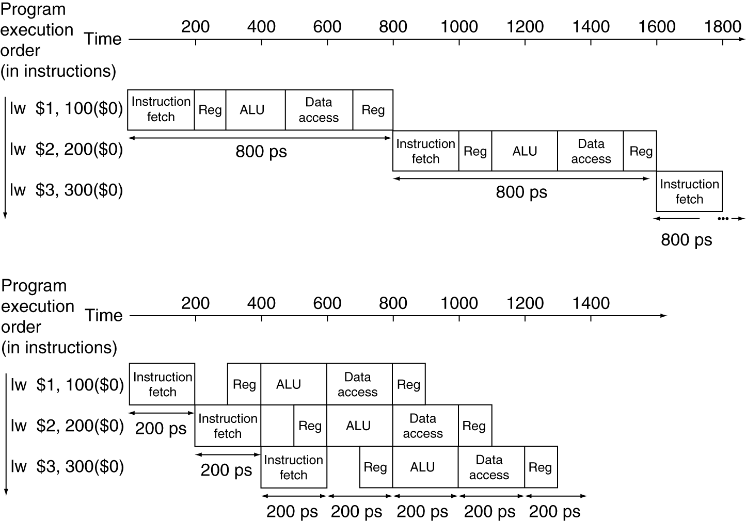
Pipeline Performance
Single-cycle (T_{c}= 800ps)
Pipelined (T_{c}= 200ps)
Chapter 4 — The Processor — <number>
Notes:
Morgan Kaufmann Publishers
Chapter 4 — The Processor

Slide 5
Pipeline Speedup
If all stages are balanced
  i.e., all take the same time
  Time between instructions_{pipelined}
  = Time between instructions_{nonpipelined}
  Number of stages
If not balanced, speedup is less
Speedup due to increased throughput
  Latency (time for each instruction) does not decrease
Chapter 4 — The Processor — <number>
Notes:
Morgan Kaufmann Publishers
Chapter 4 — The Processor

Slide 6
Pipelining and ISA Design
MIPS ISA designed for pipelining
  All instructions are 32-bits
    Easier to fetch and decode in one cycle
    c.f. x86: 1- to 17-byte instructions
  Few and regular instruction formats
    Can decode and read registers in one step
  Load/store addressing
    Can calculate address in 3rd stage, access memory in 4th stage
  Alignment of memory operands
    Memory access takes only one cycle
Chapter 4 — The Processor — <number>
Notes:
Morgan Kaufmann Publishers
Chapter 4 — The Processor

Slide 7
Hazards
Situations that prevent starting the next instruction in the next cycle
Structure hazards
  A required resource is busy
Data hazard
  Need to wait for previous instruction to complete its data read/write
Control hazard
  Deciding on control action depends on previous instruction
Chapter 4 — The Processor — <number>
Notes:
Morgan Kaufmann Publishers
Chapter 4 — The Processor

Slide 8
Structure Hazards
Conflict for use of a resource
In MIPS pipeline with a single memory
  Load/store requires data access
  Instruction fetch would have to stall for that cycle
    Would cause a pipeline “bubble”
Hence, pipelined datapaths require separate instruction/data memories
  Or separate instruction/data caches
Chapter 4 — The Processor — <number>
Notes:
Morgan Kaufmann Publishers
Chapter 4 — The Processor

Slide 9
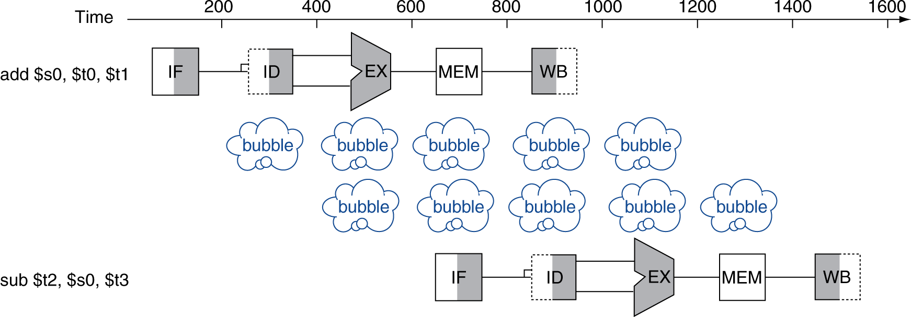
Data Hazards
An instruction depends on completion of data access by a previous instruction
  add $s0, $t0, $t1
  sub $t2, $s0, $t3
Chapter 4 — The Processor — <number>
Notes:
Morgan Kaufmann Publishers
Chapter 4 — The Processor

Slide 10
Control Hazards
Branch determines flow of control
  Fetching next instruction depends on branch outcome
  Pipeline can’t always fetch correct instruction
    Still working on ID stage of branch
In MIPS pipeline
  Need to compare registers and compute target early in the pipeline
  Add hardware to do it in ID stage
Chapter 4 — The Processor — <number>
Notes:
Morgan Kaufmann Publishers
Chapter 4 — The Processor

Slide 11
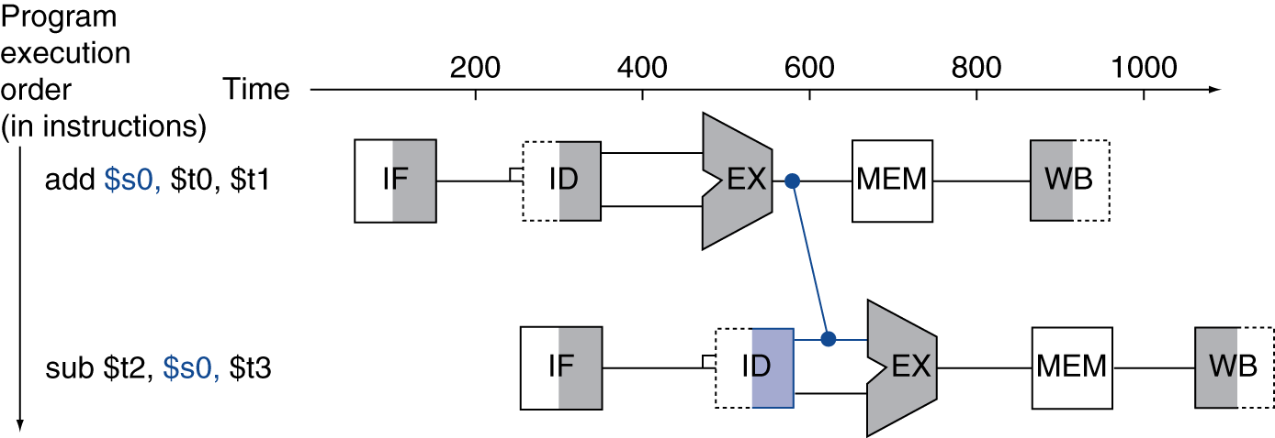
Forwarding (aka Bypassing)
Use result when it is computed
  Don’t wait for it to be stored in a register
  Requires extra connections in the datapath
Chapter 4 — The Processor — <number>
Notes:
Morgan Kaufmann Publishers
Chapter 4 — The Processor

Slide 12
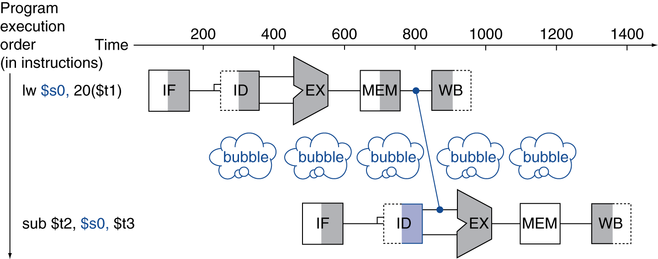
Load-Use Data Hazard
Can’t always avoid stalls by forwarding
  If value not computed when needed
  Can’t forward backward in time!
Chapter 4 — The Processor — <number>
Notes:
Morgan Kaufmann Publishers
Chapter 4 — The Processor

Slide 13
Code Scheduling to Avoid Stalls
Reorder code to avoid use of load result in the next instruction
C code for A = B + E; C = B + F;
lw $t1, 0($t0)
lw $t2, 4($t0)
add $t3, $t1, $t2
sw $t3, 12($t0)
lw $t4, 8($t0)
add $t5, $t1, $t4
sw $t5, 16($t0)
lw $t1, 0($t0)
lw $t2, 4($t0)
lw $t4, 8($t0)
add $t3, $t1, $t2
sw $t3, 12($t0)
add $t5, $t1, $t4
sw $t5, 16($t0)
stall
stall
13 cycles
11 cycles
Chapter 4 — The Processor — <number>
Notes:
Morgan Kaufmann Publishers
Chapter 4 — The Processor

Slide 14
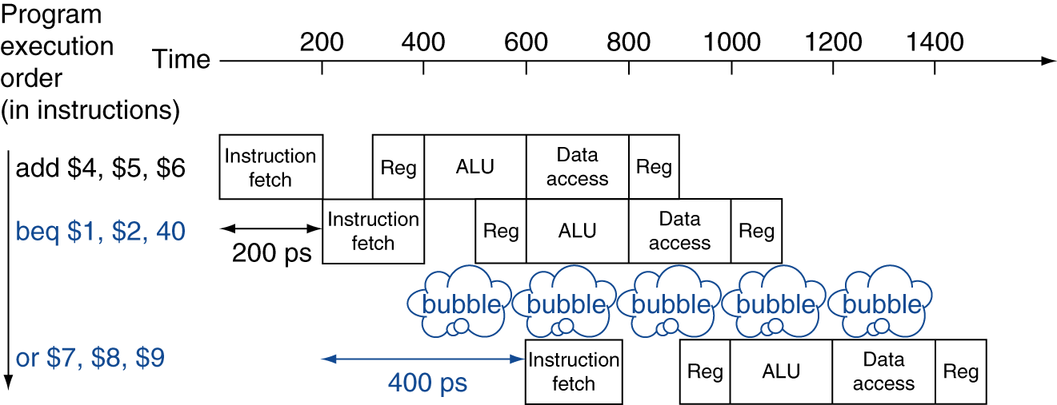
Stall on Branch
Wait until branch outcome determined before fetching next instruction
Chapter 4 — The Processor — <number>
Notes:
Morgan Kaufmann Publishers
Chapter 4 — The Processor

Slide 15
Branch Prediction
Longer pipelines can’t readily determine branch outcome early
  Stall penalty becomes unacceptable
Predict outcome of branch
  Only stall if prediction is wrong
In MIPS pipeline
  Can predict branches not taken
  Fetch instruction after branch, with no delay
Chapter 4 — The Processor — <number>
Notes:
Morgan Kaufmann Publishers
Chapter 4 — The Processor

Slide 16
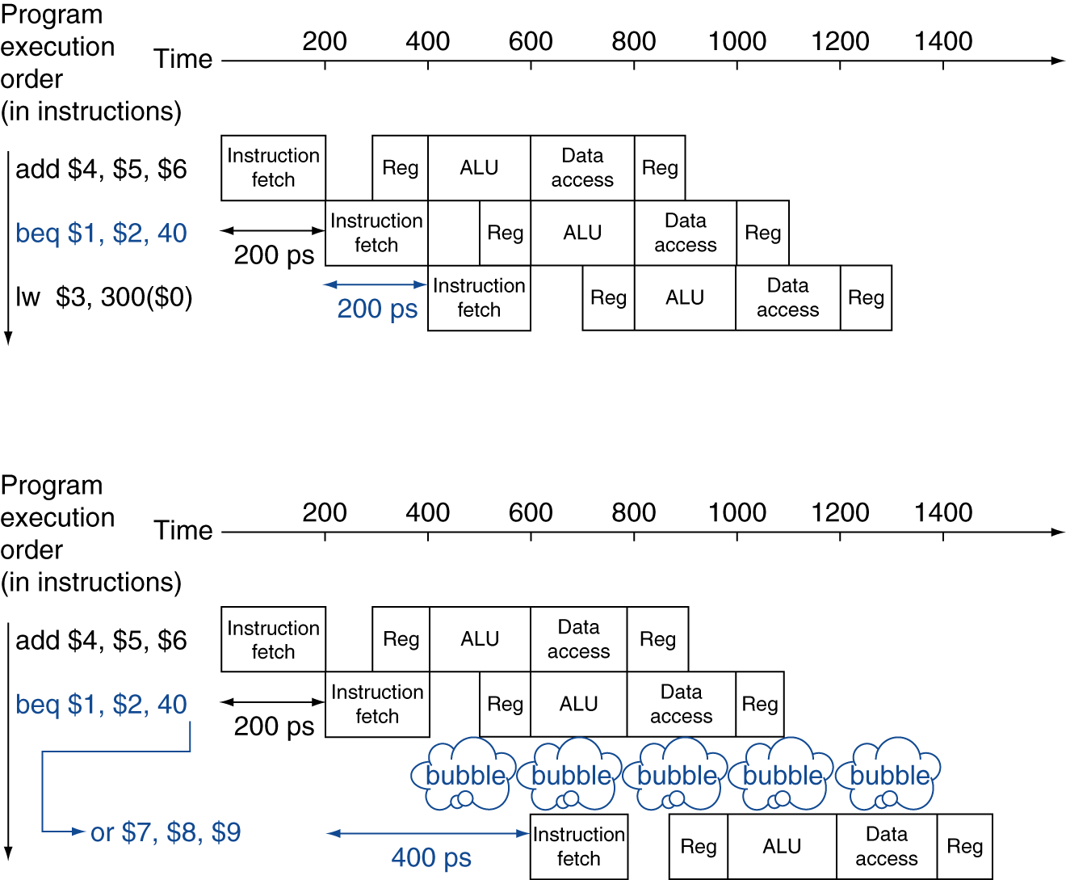
MIPS with Predict Not Taken
Prediction correct
Prediction incorrect
Chapter 4 — The Processor — <number>
Notes:
Morgan Kaufmann Publishers
Chapter 4 — The Processor

Slide 17
More-Realistic Branch Prediction
Static branch prediction
  Based on typical branch behavior
  Example: loop and if-statement branches
    Predict backward branches taken
    Predict forward branches not taken
Dynamic branch prediction
  Hardware measures actual branch behavior
    e.g., record recent history of each branch
  Assume future behavior will continue the trend
    When wrong, stall while re-fetching, and update history
Chapter 4 — The Processor — <number>
Notes:
Morgan Kaufmann Publishers
Chapter 4 — The Processor

Slide 18
Pipeline Summary
The BIG Picture
Pipelining improves performance by increasing instruction throughput
  Executes multiple instructions in parallel
  Each instruction has the same latency
Subject to hazards
  Structure, data, control
Instruction set design affects complexity of pipeline implementation
Chapter 4 — The Processor — <number>
Notes:
Morgan Kaufmann Publishers
Chapter 4 — The Processor

